Slide 1

Regulating and Managing Information Technology
Chapter 12
©2020 McGraw-Hill Education. All rights reserved. Authorized only for instructor use in the classroom. No reproduction or further distribution permitted without the prior written consent of McGraw-Hill Education.

Slide 2

Government Regulation of Technology1
  Right to be forgotten
  Intellectual property
  Software piracy
Notes:
Governments have stepped in to protect individuals and their personal information.
Right to be forgotten: Ask to remove from internet search results some personal information which is believed was damaging.
Governments have protected individuals and companies’ ideas-their intellectual property.
Intellectual property: The ideas, concepts, and other symbolic creations of the human mind.
Protected through a number of special laws and public policies, including copyrights, patents, and trademark laws.
Software piracy: The illegal copying of copyrighted software.

Slide 3
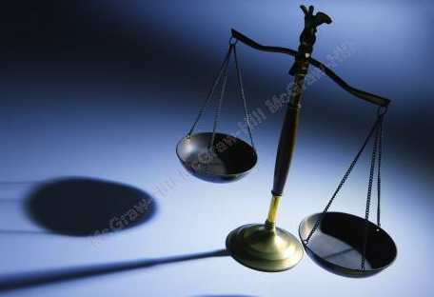
Government Regulation of Technology2
By 2018, Europe passed the General Data Protection Regulation
In 1998, the United States passed Digital Millennium Copyright Act
Notes:
By 2018, Europe passed the General Data Protection Regulation:
Regulated the processing of personal information of EU residents by an individual, a company, or an organization.
In 1998, the United States passed Digital Millennium Copyright Act:
Making it a crime to circumvent antipiracy measures built into most commercial software agreements between the manufacturers and their users.

Slide 4

The Role of Technology in Business1
Access to Stakeholders’ Personal Information
The employee-employer relationship
Big data
Consumers’ shopping habits
Notes:
Access to Stakeholders’ Personal Information
Two major market stakeholders targeted by business organizations for the collection of information:
Employees.
Consumers.
The employee-employer relationship is changing due to technological advances.
Example:
Three Square Market.
Managers often find that their strong attraction to using big data can be at odds with the protection of individuals’ rights to their own information.
Example: Verizon.
Consumers’ shopping habits are a rich source of data for businesses.
Companies tracking big data, including personal meta-data, can pick out specific details about an individuals’ shopping habits, preferences or tendencies.
Big data: Technology gives businesses access to a great deal of information.

Slide 5


E-Business and Robotics and Artificial Intelligence
E-business
  Omnichannel
  Collaborative machines
  Effects of automation on labor
  Artificial Intelligence
Notes:
E-business:
Consists of buying and selling goods and services between businesses, organizations, and individuals electronically via Internet-based systems.
E-business revenue has increased at a faster pace than that of traditional, or non-electronic, business.
Omnichannel: the idea that every distribution channel must work together to deliver a unified and consistent customer
experience.
→ Example: Amazon.
Collaborative machines: new breed of machines designed to work alongside people in close settings and changed how many small manufactures did business.
Can replace workers that could be injured from doing the work previously assigned to humans.
→Example: Panek Precision used a robot to perform difficult tasks.
Effects of automation on labor:
Threat: Job elimination:
One-half of all jobs could be lost to automation within a two decades (mostly middle-class workers: clerks and bookkeepers).
Unaffected: Safe jobs:
Jobs that appear to be safe from a robotic takeover involve managing and developing people, and work that applies expertise to decision making, planning or creative work.
Creation: New jobs:
The presence of technology might allow low-skilled workers to perform tasks previously assigned only to high-skilled employees.
Artificial Intelligence: the ability of a digital computer or computer-controlled robot to perform tasks commonly associated with intelligent beings.
Examples:
Royal Dutch Shell.
BlackRock.
Autonomous vehicles.

Slide 6
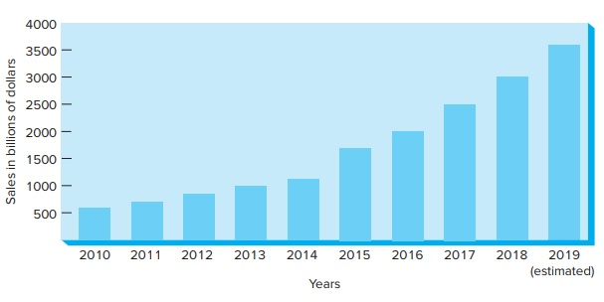
Global E-business Sales Growing
Figure 12.1
Copyright © McGraw-Hill Education. Permission required for reproduction or display.
Access the text alternative for these images.

Slide 7


The Chief Information, Security, Technology Officer
Businesses often entrust the responsibility for managing information technology and its many privacy and security issues to the chief information officer (CIO).
Cybercrime criminal activity done using computers and the Internet.
Notes:
Businesses often entrust the responsibility for managing information technology and its many privacy and security issues to the chief information officer (CIO).
Or, individuals with similar titles: chief security officer or chief technology officer.
Cybercrime: criminal activity done using computers and the Internet.
Examples:
Anything from downloading illegal music files to stealing millions of dollars from online bank accounts.
Non-monetary offenses, such as creating and distributing viruses on other computers.
Posting confidential business information on the Internet.
Committed by individuals or groups gaining unauthorized access to a business organization through its computer system.
Hackers: Individuals, acting alone or in groups often with advanced technology training, who, for thrill or profit, breach a business’s information security system.

Slide 8
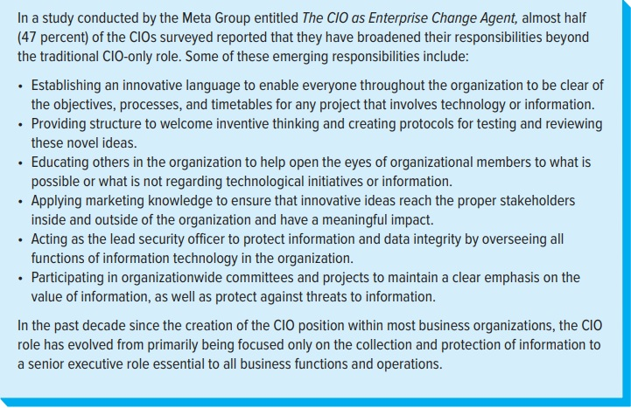
The Roles and Responsibilities of the Chief Information Officer (CIO)
Copyright © McGraw-Hill Education. Permission required for reproduction or display.
Figure 12.2
Access the text alternative for these images.

Slide 9
Why Do Hackers Hack?
From Figure 12.3
Copyright © McGraw-Hill Education. Permission required for reproduction or display.
While hackers may have any number of reasons underlying the motivations for their actions, three of the more common motivations appear to be:
1. Hackers hack to profit from their actions—the financial-incentive motive.
2. Hackers hack in retaliation against action or inaction by a company or government—the retaliation motive.
3. Hackers hack to gain media attention for their political or social viewpoint or to boost their own ego—the seeking media attention motive.

Slide 10


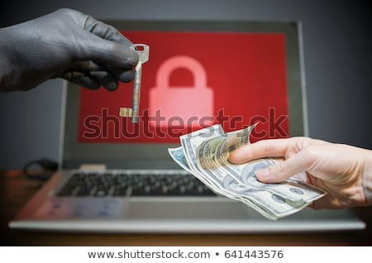
Costs of Cybercrime1
Hiscox Insurance report
Ransomware Attack
Most companies are behind on their security efforts
Notes:
In 2016, Hiscox Insurance reported that cybercrime cost the global economy over $450 billion.
The Ponemon Institute stated that:
In the United States, the average cost of a data breach was over $7 million.
Most costs were incurred during intrusion detection and when attempting to recover.
Significant costs were attributed to disruption of the business organization’s computer systems.
Breaches also resulted in regulatory fines, legal costs, and an increase in the average cost for each lost or stolen record containing sensitive and confidential information.
Ransomware attack: a kind of cyberattack in which malware locks the data on a victim’s computer and demands payment to decrypt the data.
Responsible for 51 percent of all cyberattack incidents in 2017.
Average amount paid by victims of ransomware was $1,077.
According to McKinsey & Company, companies were struggling with their capabilities to keep up with criminals when it came to cyber-risk management.
As more and more highly visible breaches occurred with growing regularity, most technology executives believed that they were losing ground to cyberattackers.

Slide 11
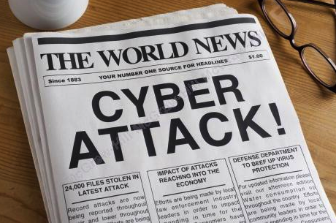


Business and Government Efforts to Combat Cybercrime1
Incident-response plan for cyberattacks
White hatters
North Atlantic Treaty Organization (NATO) ratified a change in the organization’s mission of collective defense
European Union passed the General Data Protection Regulation
Notes:
Many businesses have gone to great lengths to build strong defenses to protect information and ensure stakeholder privacy.
Experts encourage companies to develop an incident-response plan for cyberattacks.
These plans compliment the effort to prevent access to information but also focuses on what to do when a breach occurs.
Reduce criminal intrusion of their sites by paying hackers, often called white hatters.
Businesses use the white hatters’ computer skills to identify weaknesses in the company’s information systems.
Since 2007, representatives from the United States and dozens of European countries have gathered annually for what is known as Data Privacy Day, held annually on January 28th.
To raise awareness and empower people to protect their privacy, control their digital footprint, and escalate the protection of privacy and data as everyone’s priority.
In 2014, leaders of the North Atlantic Treaty Organization (NATO) ratified a change in the organization’s mission of collective defense.
For the first time, a cyberattack on any of the 28 NATO nations could be declared an attack on all of them.
The European Union passed the General Data Protection Regulation in 2018.
Applies to all companies that did business in any of the 28 countries that comprised the EU and the UK.
Must disclose promptly when data had been breached.
Additional coordinated efforts by international governmental agencies are needed to better ensure that the threat of cyberattacks are thwarted.

Slide 12
Regulating and Managing Information Technology
Chapter 12
©2020 McGraw-Hill Education. All rights reserved. Authorized only for instructor use in the classroom. No reproduction or further distribution permitted without the prior written consent of McGraw-Hill Education.

